Slide 1
DEPARTMENT OF ISE, HASSAN
Internship Phase – 2 Presentation​
(22INT) ​
Internship Title: Android App Development using Gen AI
Company: MindMatrix
Name: KIRAN P S
USN: 4MC22CS082
Branch: Computer Science & Engineering
Course: Android App Development using Gen AI
Internship Guide​
Mrs. Prakruthi m b
Associate Professor ​
Department of CSE ​
MCE, Hassan​

Slide 2
Jal-Sanchay Tracker
INTRODUCTION:
Jal-Sanchay Tracker is a sustainability-focused Android application created to make rainwater harvesting measurable and understandable for everyday users.
The app provides a guided journey from setup to rainfall entry, dashboard monitoring, reporting, impact calculation, and practical tips. It is developed using Kotlin, Jetpack Compose, Room Database, Hilt, and MVVM architecture.
the app helps users see how much water has been saved, how full their storage tank is, and how many household water days that saving represents. This improves awareness, encourages conservation habits, and makes rainwater harvesting more actionable.

Slide 3
Problem Statement:
Many households have rainwater harvesting systems but no simple way to measure whether they are actually effective. Without a clear record of rainfall, roof catchment, and stored water, conservation stays conceptual instead of practical. Manual tracking is inconsistent, calculations are often skipped, and users rarely understand how rainfall translates into daily household impact. In addition, most users need a clean and easy interface rather than a technical system. A mobile application is therefore required to store historical rainfall data, estimate water savings automatically, and present the result through clear visuals such as tank progress, reports, and impact views.

Slide 4
The Problem it Solves In many regions, especially in India, households have rainwater harvesting systems installed, but they lack a way to measure their impact. Without data, water conservation feels like an abstract concept rather than a tangible achievement. People don’t know: How much water they are actually saving. How much of their tank is full after a specific rainfall. How many days that saved water will actually last for their family Aim:
To design and implement a user-friendly Android application that helps households record rainfall, estimate harvested water, track storage progress, and understand the practical impact of rainwater conservation.

Slide 5
Simple Setup Allow the user to save household details like roof area and tank capacity. Rainfall Entry Record rainfall values with validation and local storage. Live Dashboard Show water saved and animated tank progress. Monthly Report Summarize total and monthly harvested water clearly. Impact Score Convert litres into understandable household water days. User Guidance Provide practical tips for better rainwater harvesting.
OBJECTIVES:

Slide 6
System Requirements:
Software Requirements
1. Programming Language:
Kotlin/java
2. UI Toolkit:
Jetpack Compose,
3. Database:
Room Database (SQLite)
4. Architecture / Libraries:
Hilt, MVVM
5. Development Tools:
Android Studio, Gradle, Android SDK

Slide 7
How the App Works (Functionality): The app follows a logical flow to convert environmental data into household utility: Setup: The user inputs their specific home data, including Roof Area, Tank Capacity, and Roof Material (which affects the runoff coefficient/efficiency). Data Entry: Users manually enter rainfall in millimeters (mm). The Logic: The app uses a specific formula to calculate harvestable water: Water Saved = Area*Rainfall*0.0929* Visual Dashboard: It features a "Water Tank" progress bar that visually fills up based on the data entered, making the storage level easy to understand at a glance.

Slide 8
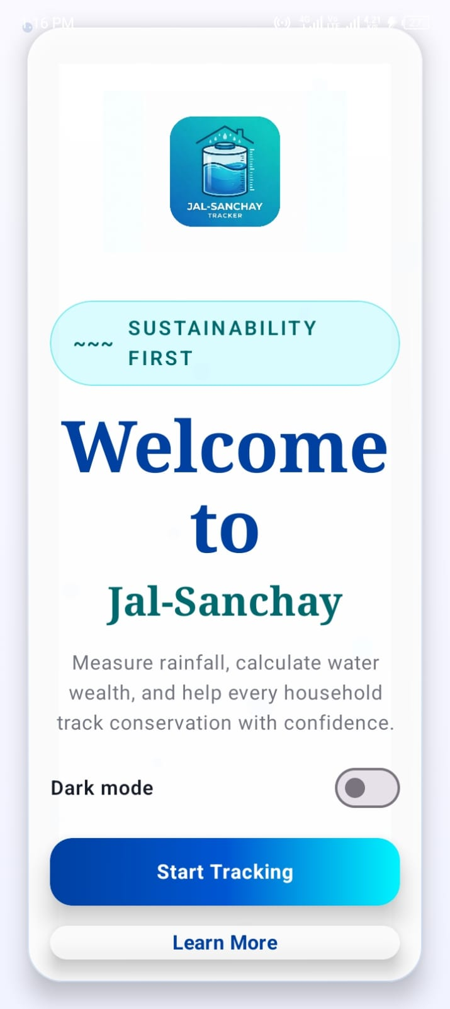
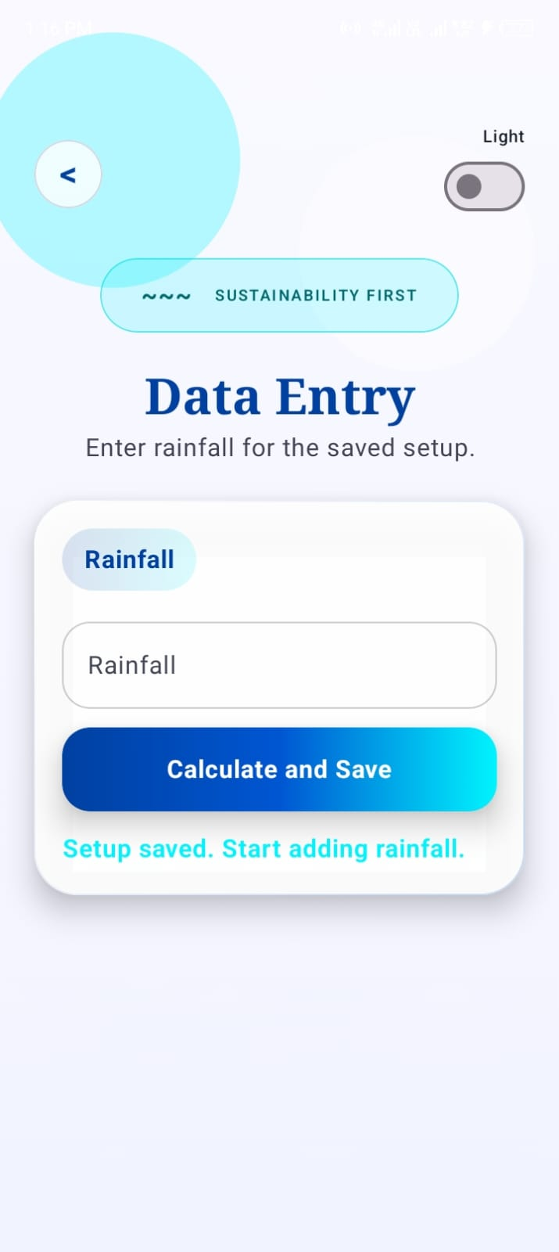
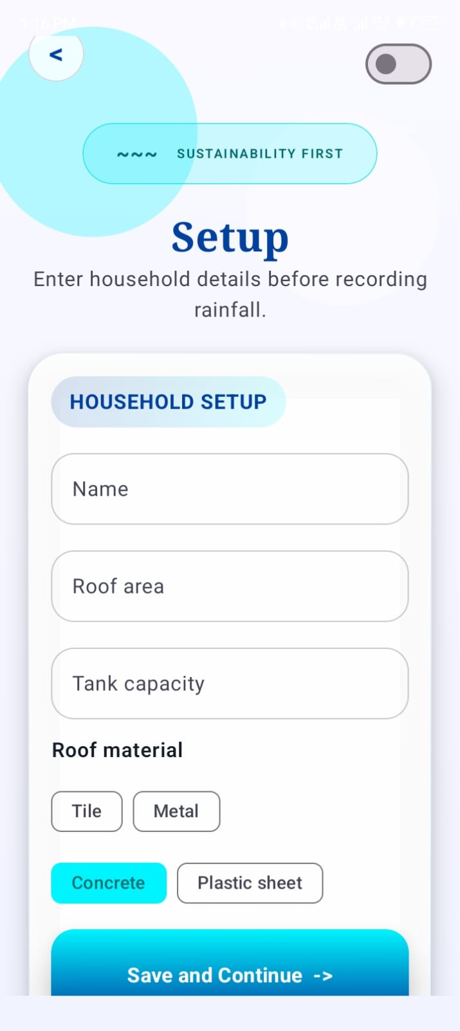
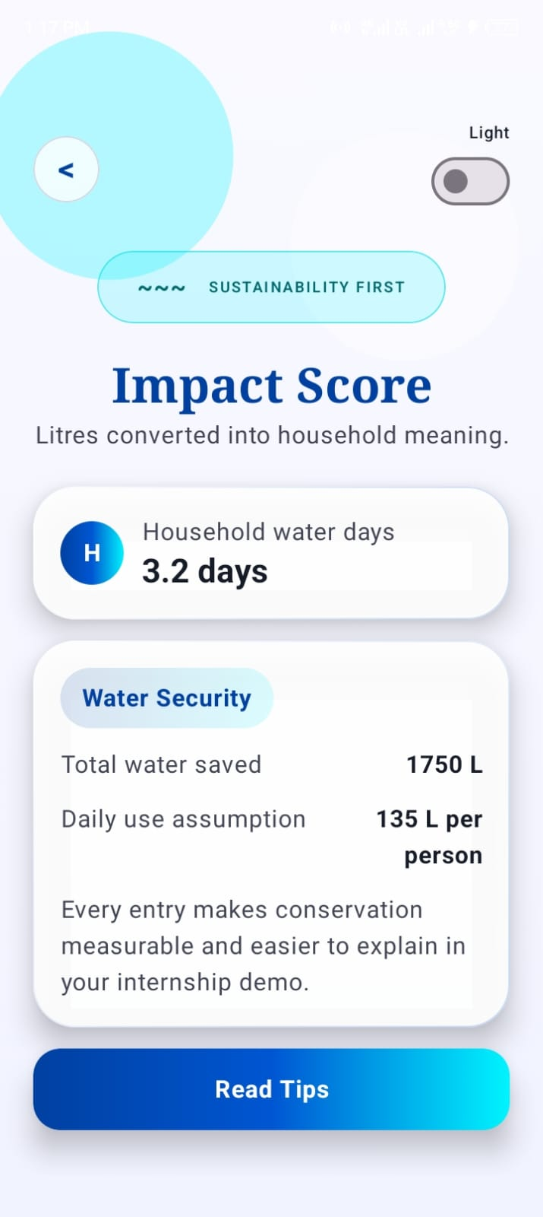
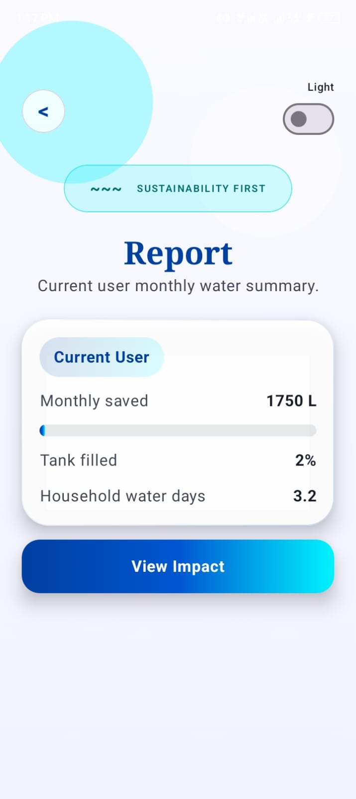
Welcome Page
Setup Page
Dashboard / Report
Impact / Tips

Slide 9
CONCLUSION:
Jal-Sanchay Tracker successfully demonstrates how an Android application can turn rainwater harvesting into a measurable and user-friendly household activity. By combining setup data, rainfall entry, local Room storage, and a reactive Jetpack Compose dashboard, the system gives users clear feedback about litres saved, tank progress, and household impact. The project also highlights good Android development practices through MVVM architecture, Hilt dependency injection, validation logic, and real-time state updates using Flow and StateFlow. Overall, the application promotes sustainability awareness while serving as a strong internship-level implementation of Kotlin Android development.

